Slide 1

Health Data Analysis
SRM INSTITUTE OF SCIENCE AND TECHNOLOGY
18CSE396T – DATA SCIENCE
Snehal Sukundari (RA2111027010049)
Ratan Priya Singh (RA2111027010065)

Slide 2

1. Introduction 2. Motivation 3. Problem Statement 4. Dataset 5. Output 6. Conclusion 7. References

Slide 3
Introduction
Health data analysis plays a vital role in shaping the future of healthcare, enabling evidence-based decision-making, and ultimately improving the quality of care and the overall health of populations.
It helps us understand diseases, identify risk factors, and develop effective treatments.
Analyzing health data to predict medical bills is a critical area of research and application that can significantly benefit both healthcare providers and patients.
Predicting bills accurately requires understanding and integrating insurance plan details into the analysis.

Slide 4
Motivation
Big part of life is insurance and insurance companies charge individuals premiums based off some basic information of who they are, where they live and what they do.
Insurers use predictive modeling to estimate future healthcare costs, which can inform pricing and risk management strategies. Analyzing health data can enhance the accuracy of these models.
They have this problem that if they charge too much they’re going to lose customers but if they charge enough they‘re going to go out of the business and be bankrupt.

Slide 5
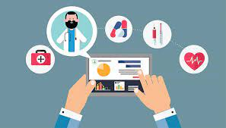
Problem Statement
Health Data Analysis provides data to local health authorities, healthcare providers, and policymakers to guide the allocation of resources. To predict how much a given customer’s cost for the medical bill for the year based on some generic features, in this project we’ll use R to create regression model.

Slide 6
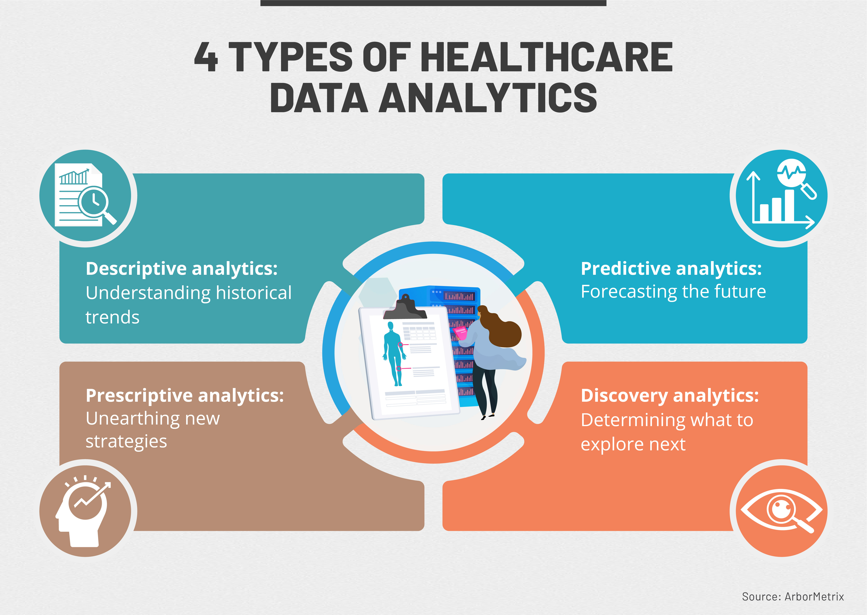


Slide 7
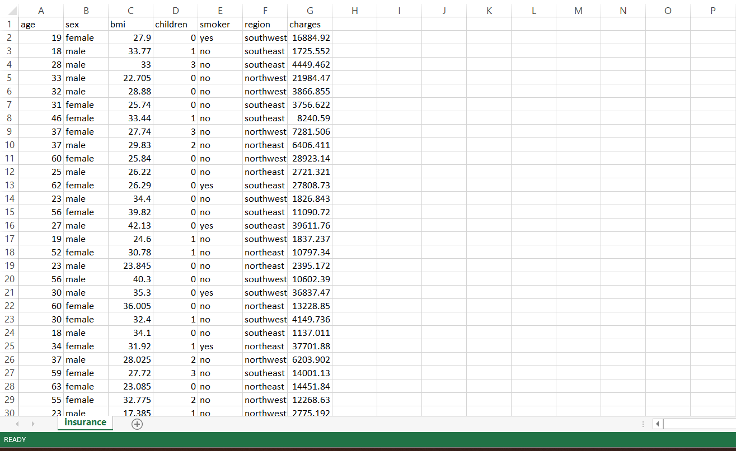
Dataset

Slide 8
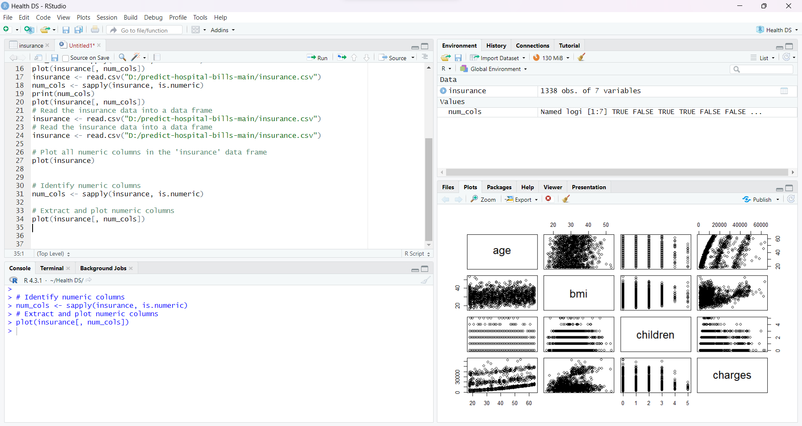
Output

Slide 9
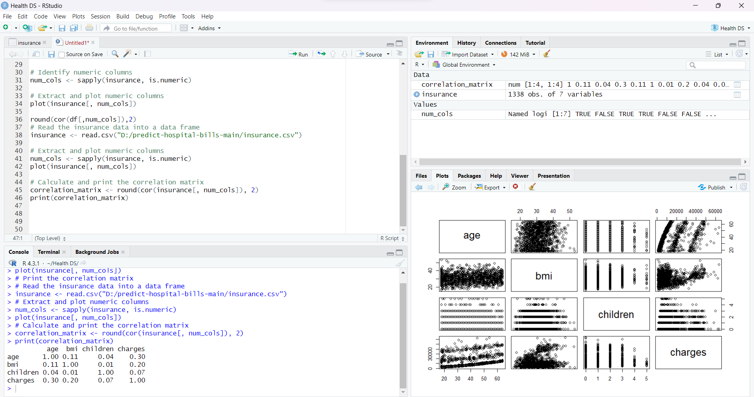
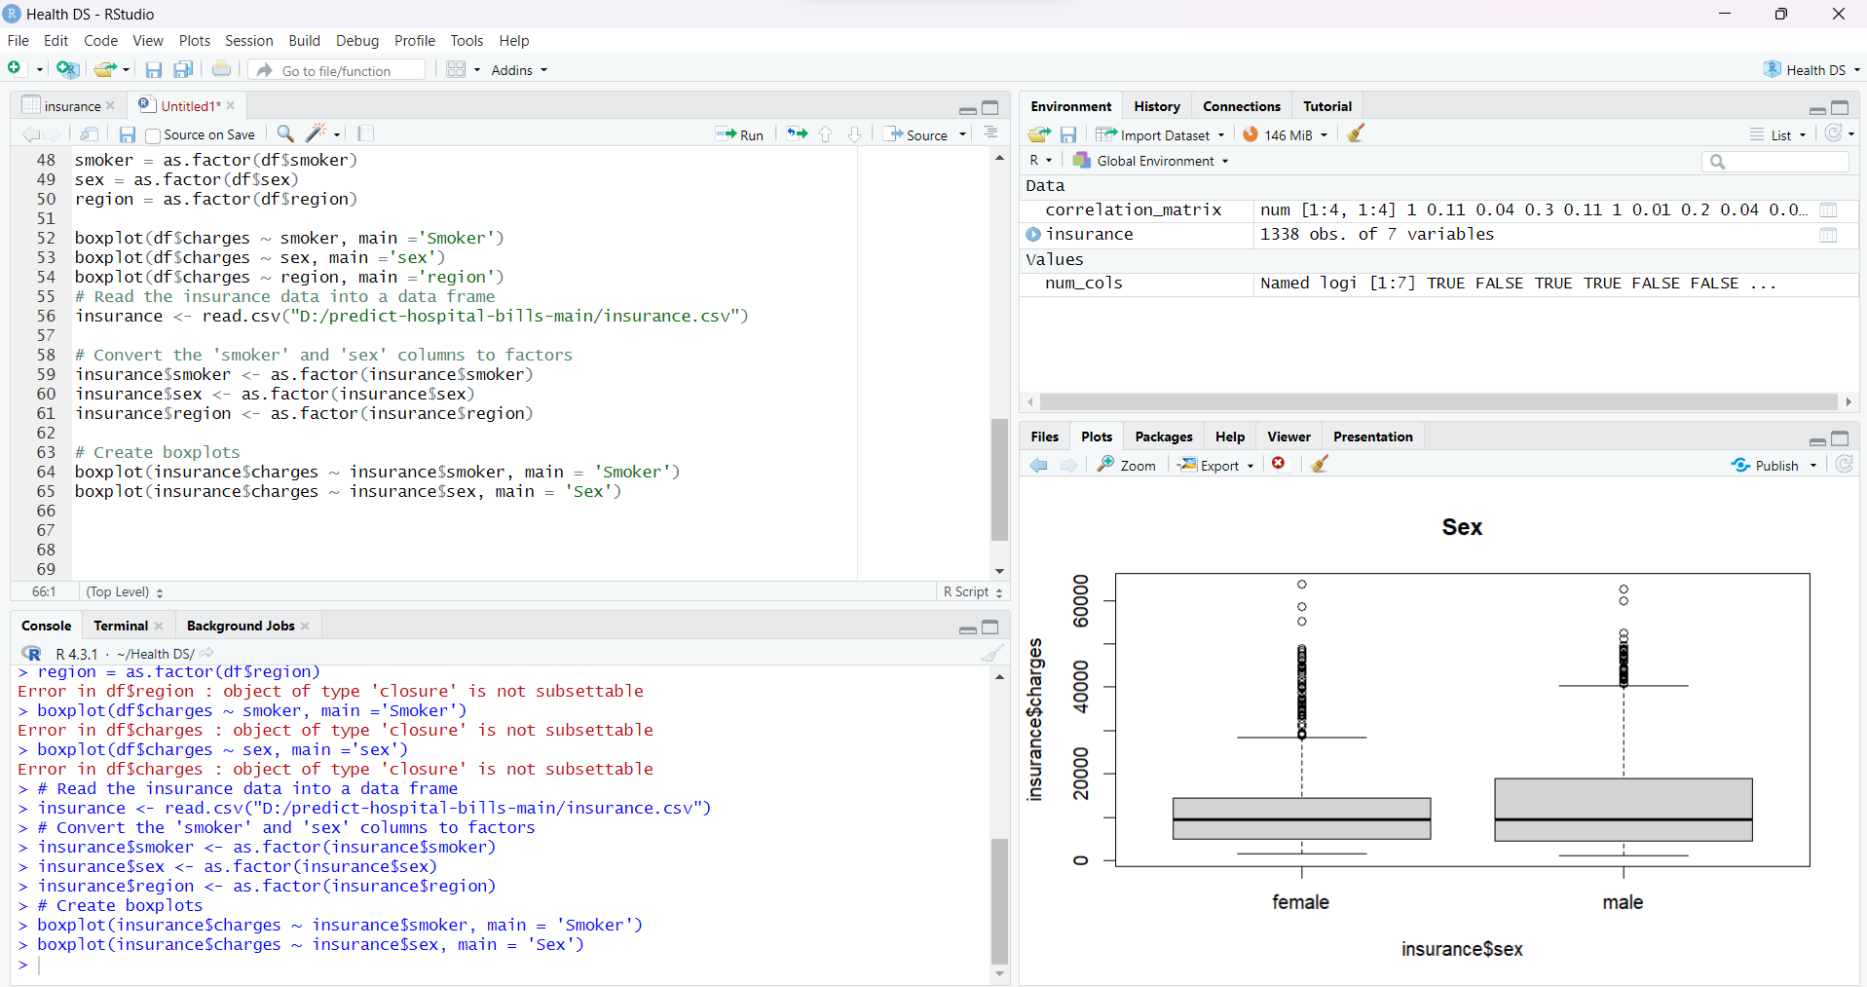

Slide 10
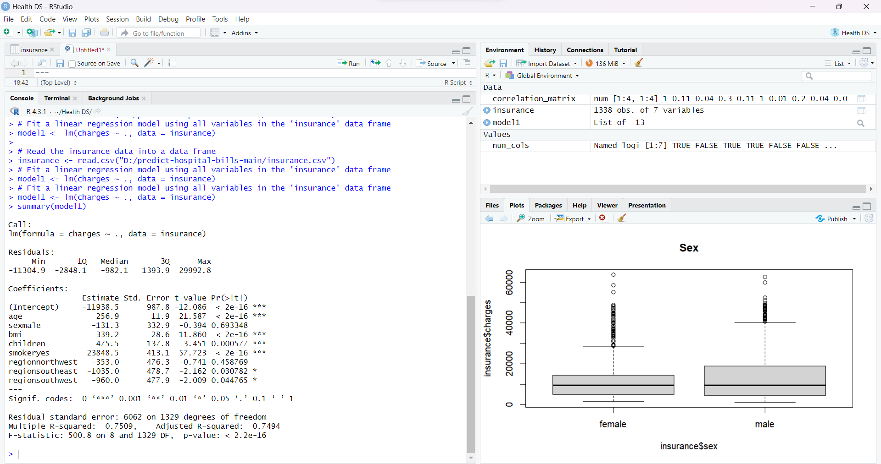

Slide 11
Conclusion
In conclusion, using R Studio for health data analysis provides a powerful and versatile tool for extracting valuable insights from complex healthcare datasets. The integration of R's vast libraries, along with the ability to generate publication-quality graphs and reports, makes it an essential resource in the pursuit of better health outcomes and medical research.

Slide 12
THANK YOU
References
https://www.youtube.com/watch?v=6zjkJ2A5Cc8
https://www.datacareerjumpstart.com/blog/predictbills
https://bookdown.org/drki_musa/dataanalysis/
https://towardsdatascience.com/analyze-health-insurance-data-using-rstudio-85f1c1e37ec8

